Slide 1
Presentation on 3G Data Card - TSEC
Model No. LW272 for 3.6 Mbps & LW273 for 7.2 Mbps

Slide 2
Description of functions/ features as per new tender
Model No. LW272 for 3.6 Mbps & LW273 for 7.2 Mbps

Slide 3
Frequency Bands Supported
3.6 Mbps 3G Data Card supports Quad-band for 2G (850, 900, 1800, 1900 MHz) & Single band for 3G (2100 MHz) for HSDPA 3.6 Mbps type data card.
7.2 Mbps 3G Data Card support Quad-band for 2G (850, 900, 1800, 1900 MHz) & tri band for 3G (850, 1900 & 2100 MHz) for HSDPA 7.2 Mbps type data card.

Slide 4
Over view of GUI and Data Card

Slide 5
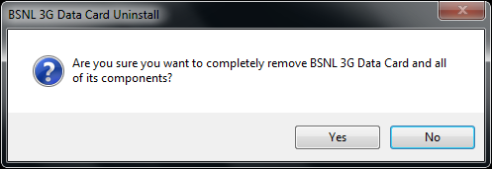
Installation & Uninstallation

Slide 6
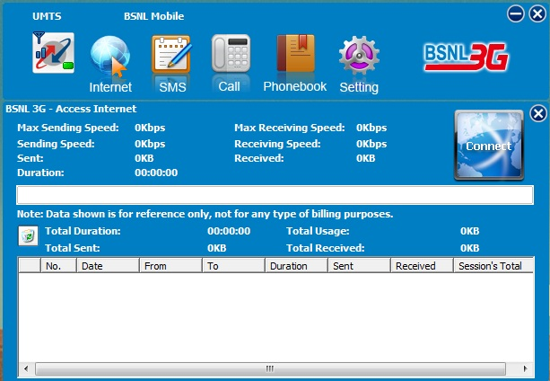
Connect Buttons

Slide 7
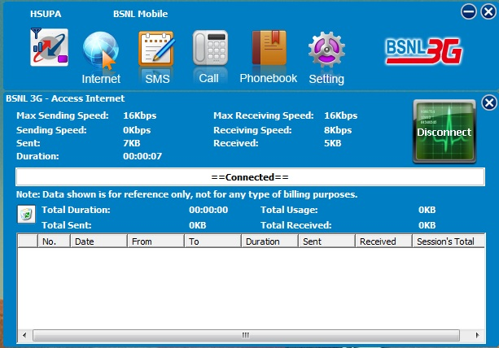
Disconnect Button

Slide 8
Support of 16 GB Memory Card

Slide 9
Support For Voice Functionality – Making Outgoing Call

Slide 10
Support for SMS Functionality – Making Outgoing SMS

Slide 11
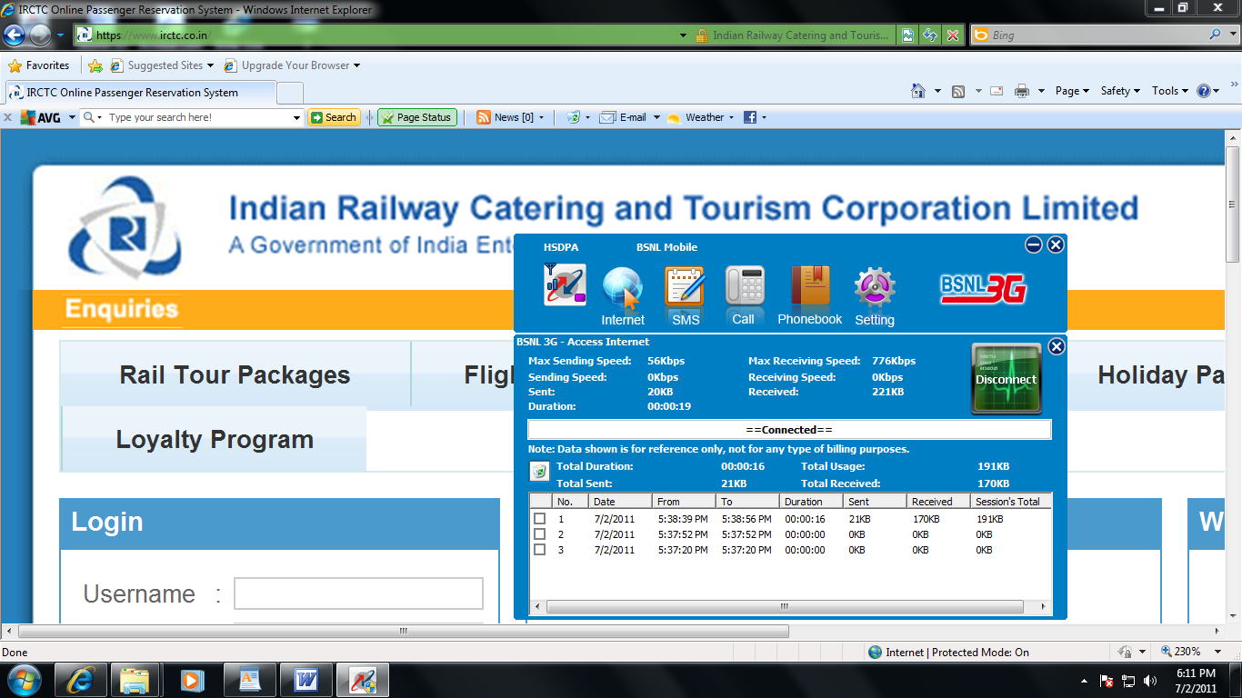
Support for Data Functionality – Browsing Internet

Slide 12
Support of security features

Slide 13
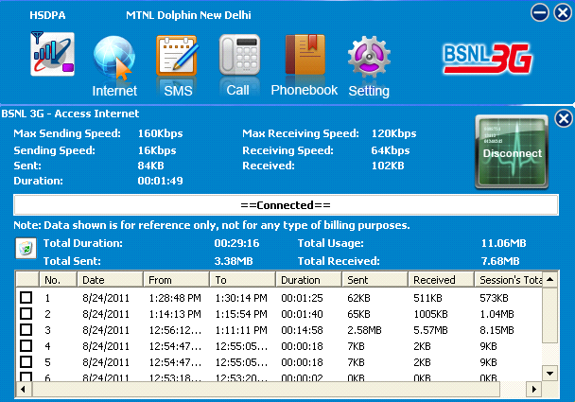
Working in Roaming Partner’s Network (MTNL Delhi)

Slide 14
Support of Cell Broadcast Service (CBS)

Slide 15
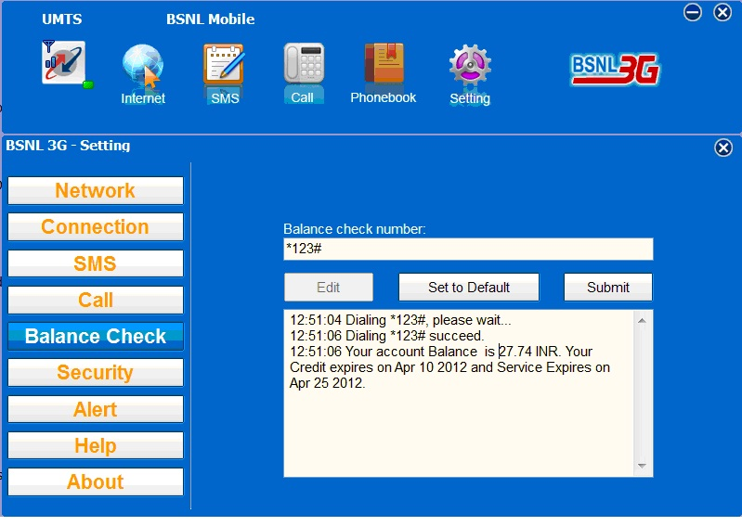
Support of USSD Services: *123# Function

Slide 16
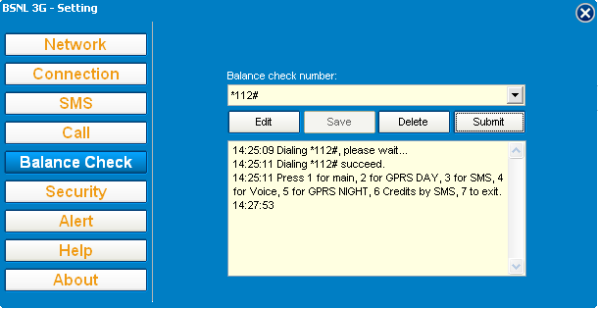
Support of USSD Services: *112# Function

Slide 17
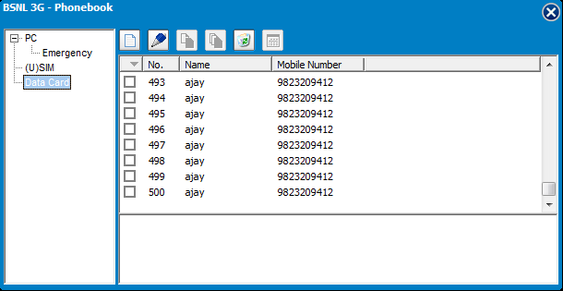
Capacity to Store 500 Contact nos. in Data Card

Slide 18
Support of own number feature

Slide 19
SMS of 160 Characters – Storage of 250 nos

Slide 20
Network Selection Mode – Auto Select

Slide 21
Network Selection Mode – Manual Select

Slide 22
Call Control – Call Forward

Slide 23
Call Control – Bar All Outgoing Calls

Slide 24
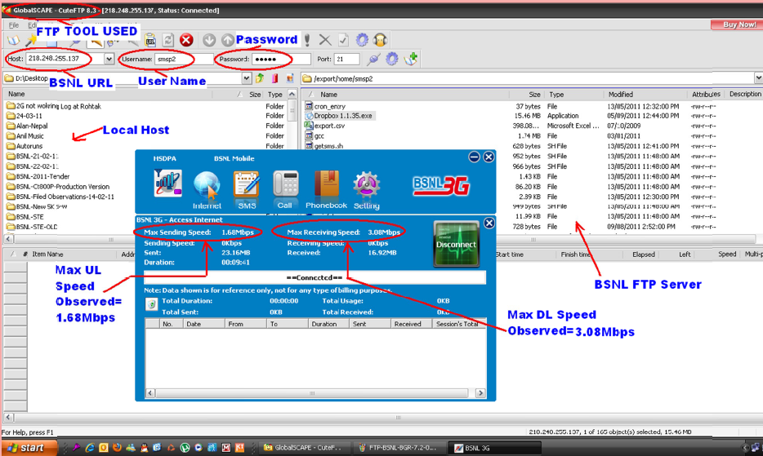
Max speed observed in 3.6 Mbps Data Card: 3.08 Mbps

Slide 25
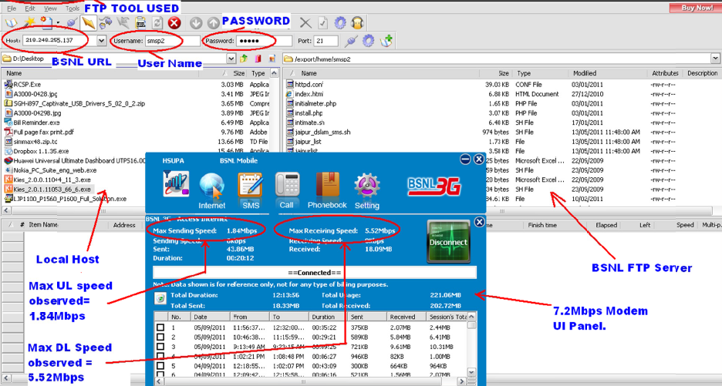
Max speed observed in 7.2 Mbps Data Card: 5.52 Mbps

Slide 26
Support of Device functionality with Multi-Vendor Data Cards

Slide 27
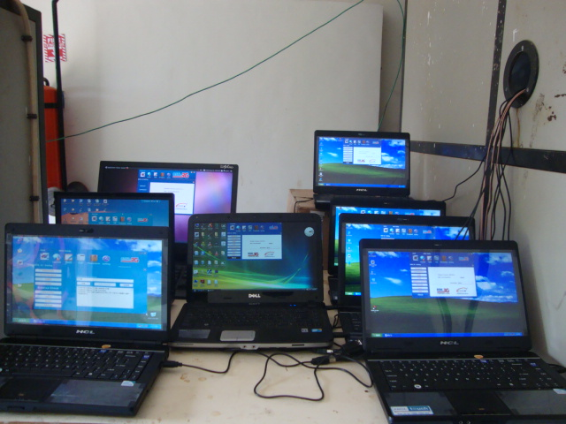
Support of Device functionality with Multi-Vendor Laptops
All Brand Laptops

Slide 28
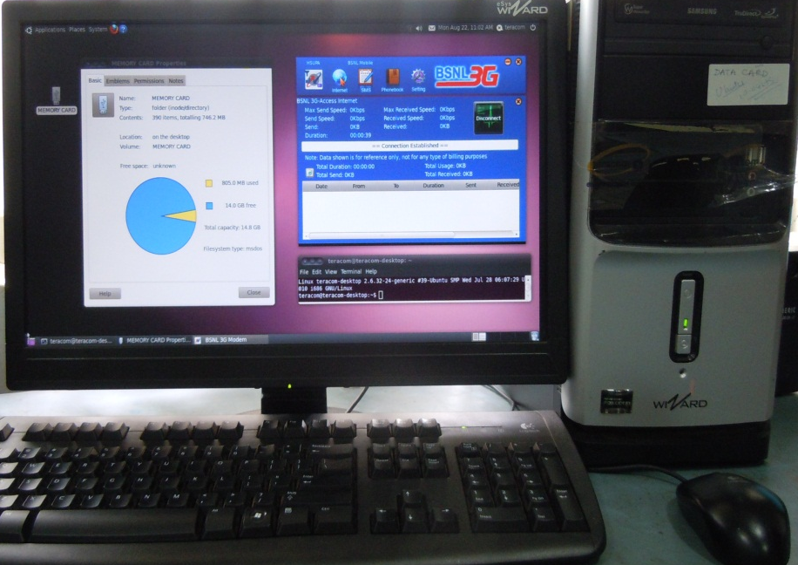
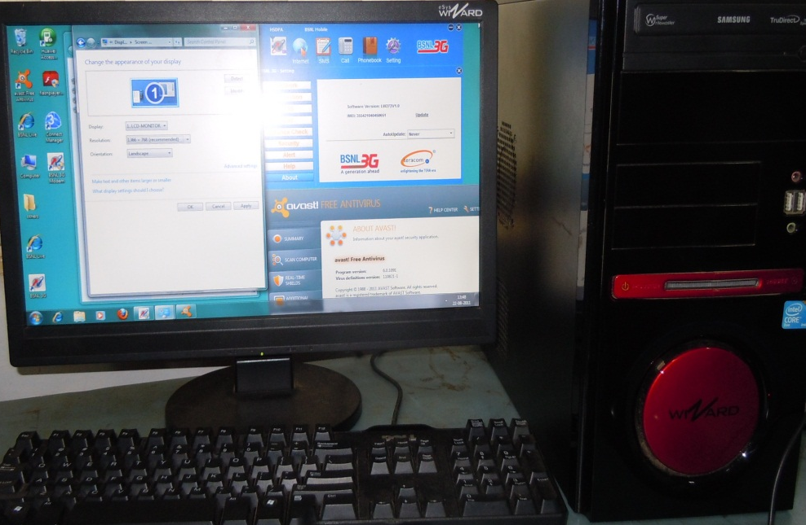
Support of Device functionality with Multi-Vendor PC

Slide 29
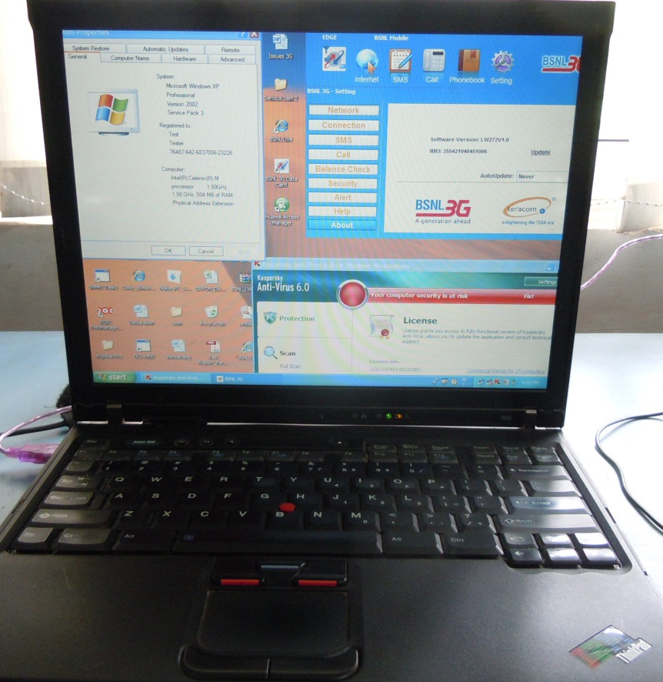
Support of Device functionality with Multi-Vendor Laptop/PC
IBM Think pad Apple

Slide 30
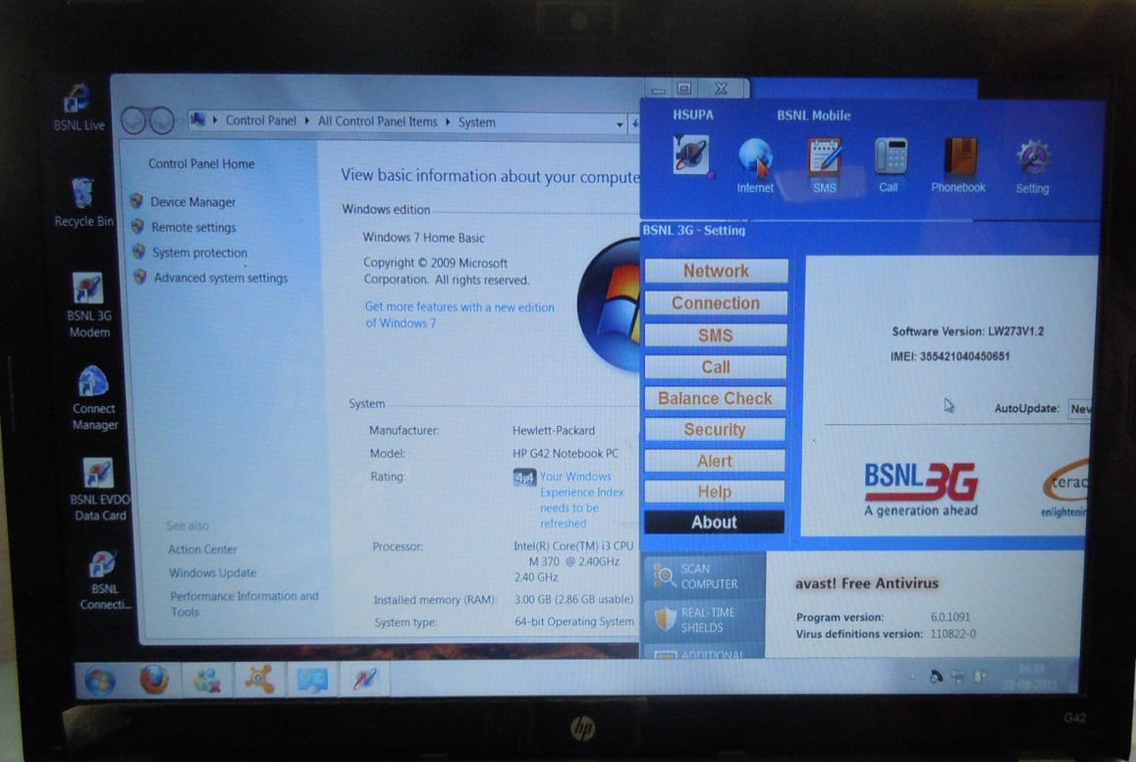
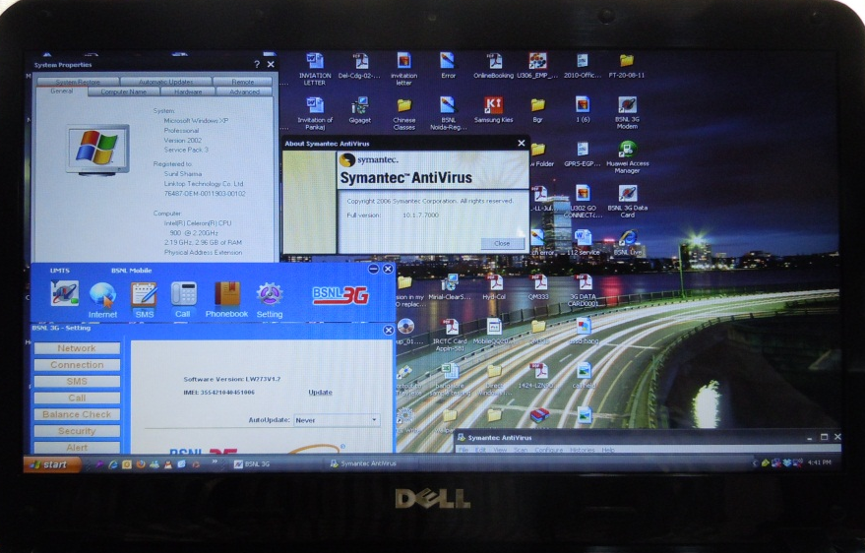
Support of Device functionality with Multi-Vendor Laptop/PC
DELL
HP

Slide 31
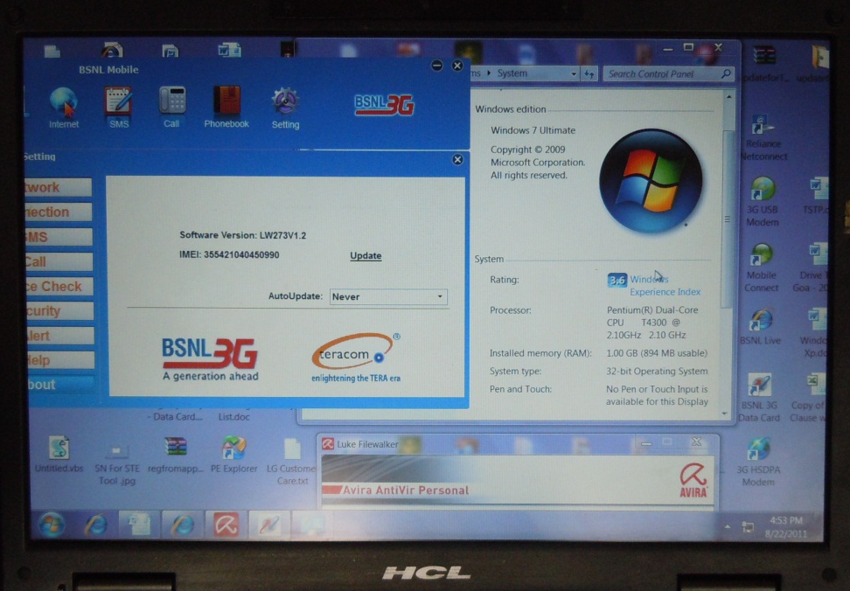
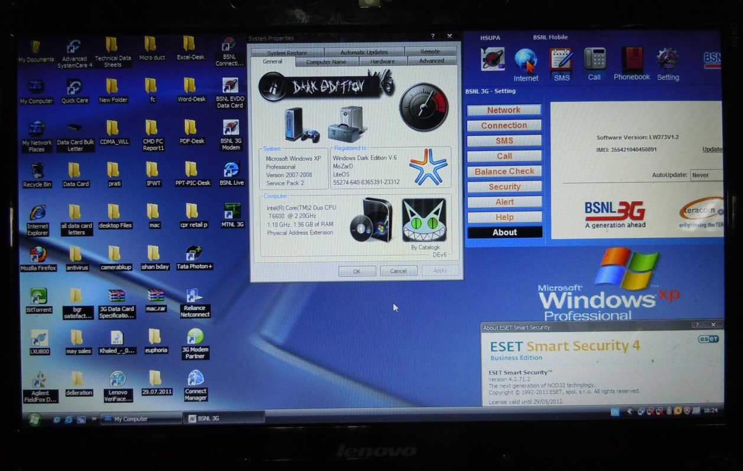
Support of Device functionality with Multi-Vendor Laptop/PC
LENOVO
HCL

Slide 32
Support of International Roaming Facility

Slide 33
Support of International Roaming Facility

Slide 34
Support of International Roaming Facility

Slide 35
OS Supported by Data Card
Windows 7
Windows Vista
Windows XP
Windows 2000
Mac 10.4, 10.5 &10.6
Linux (Ubuntu) 10.04 & 11.04

Slide 36
Technical Status of Data Card
Model No. LW272 for 3.6 Mbps & LW273 for 7.2 Mbps

Slide 37
Technical Status of Data Card
Sl.No. | Features | Status during last TSEC | Present status
1 | New appearance of GUI | Solid Color Combinations were used for GUI. | Grediant Color are used to makenew good look appearance of GUI along with new good looking Icon buttons
2 | Same GUI for All Supporting OS | linux and MAC was having same GUI so that one not to confuse about functionality due to different GUI. | Data Card having same GUI so that one not to confuse about functionality due to different GUI
3 | USSD Support | Not Available and was not a part of tender | Data Card support USSD functions (Balance Check etc.) on all OS. For user’s convenience it is designed with *123# set as factory default USSD setting which is Editable as per requirement.
4 | Cell Broadcast Service (CBS) Function Support | Not Available and was not a part of tender | Data Card Support Cell Broadcast Service (CBS) function on all supported OS.
5 | Receiver Diversity Support | Not Available and was not a part of tender | New Data Card supports receiver diversity. It has two inbuilt antennas namely Main and Auxillary.

Slide 38
Technical Status of Data Card
Sl.No | Features | Status during last TSEC | Present status
6 | Standby Mode Support | Not Available and was not a part of tender | Data Card support Standby Mode to reduce power consumption while Data Card not in connected mode. Time defined for standby mode is ranging from “Never” to 1 Day. Default is set as “Never”.
7 | Call Waiting Function | Call Waiting Feature was supported with essential functionality like display of Name/Number of Callee. Extended features like Call on hold and call switching funcition was not available. | New Data Card support “Call On Hold” & “Call Switching” function as an extension of Call Waiting function. It will help user to “Hold & Switch-Over” between Calls.
8 | Call Forward Function | Searching of contact was not possible on old data card for call forwarding. | Data Card Support Searching of Contact from Phonebook in Call Forward Function. Now user doesn’t need to enter forwarded number manually (if number is already stored in phonebook).

Slide 39
Technical Status of Data Card
Sl.No. | Features | Status during last TSEC | Present status
9 | LED Indication | 4 Color Virtual LED on GUI was available. 2 Color LED was supported on Hardware | 4 Color LED indication is supported on Data Card as well as GUI in synchronized manner. LED Indications are as follows: A. RED: Network Searching/Latching B. BLUE: GSM/GPRS/EDGE (2G) C. GREEN: UMTS (3G) D. PURPLE: HSDPA (3G)
10 | SMS Storage | Apart from Logically Unlimited capacity of SMS storage in PC, Data Card was supporting 200 nos. of SMS | Apart from Logically Unlimited capacity of SMS storage in PC, Data Card itself supports 250 SMS of 160 characters each.
11 | Phonebook Storage | Apart from Logically Unlimited capacity of Phonebook storage in PC, Data Card itself supported 500 nos. of Contact details. | Apart from Logically Unlimited capacity of Phonebook storage in PC, Data Card itself supports 500 Contact details.

Slide 40
Technical Status of Data Card
Sl.No. | Features | Status during last TSEC | Present status
12 | Removal of “Audio Device” Button | It was required to select "Audio Device" button of data card once after installation of device to make it default audio device. | “Audio Device” button is removed. Now user no needs to click on any button even for a single time to listen music when Data Card is inserted first time
13 | Compatibility with Old Supplied Data Card | Was not a part of tender. | Data Card is fully compatible with old Supply of Data Card. If Old supply Data Card is already installed, New Data Card installed separately as launches itself as stand alone application.
14 | Compatibility with other make Data Cards | Was not required as other make data cards were launched in market after BSNL Tender only. | Data Card works with other make Data Cards

Slide 41
Technical Status of Data Card
Sl.No. | Features | Status during last TSEC | Present status
15 | Note for Data Statistics | Was not a part of tender. Hence not provided | “Data Shown is for reference only. Not for any type of billing purposes.” Note is displayed in GUI when user clicks on internet button. Note is provided so that user not confuse about Data Statistics w.r.t. Statistics of BSNL's Billing System.
16 | Working with Antivirus | Was not a part of tender. Hence not provided. Hence Tested with Available Antivirus (Not Specific Antivirus like Avira, Norton etc.) during Validation. | Data Card Works well with Popular Antivirus (Avira, Norton etc.)
17 | Compatibility with different OS & Different Vendor’s Laptop/PC | Was not a part of tender. Hence Tested with Available Different Vendor's Laptop/PC during Validation. | Data Card is compatible with OS (Windows Xp/Vista/7, MAC OSX, Linux Ubuntu). It supports different vendor’s Laptop/PC (Tested with HCL ME/HP Pavilion, Dell Vostro etc.)

Slide 42
List of our Technical Engineers across the country
Model No. LW272 for 3.6 Mbps & LW273 for 7.2 Mbps

Slide 43
List of our Technical Engineers
Circle | Contact Person | Contact No. | E Mail ID
Assam | Shrawan Kumar | 09401700071 | Customercare@teracom.in
 | Mintoo | 09854217019
 | Pradip baishya | 09401365226
Bihar | Vijay chaudhary | 09472277188
 | Guddu Kumar Jha | 08986181528
 | Alok Chaudhary | 07549937881
 | Prem Ranjan | 09472077846
 | Om Prakash | 09472241213
Chattisgarh | Harsh Bharadwaj | 09406440997
 | Ajeet Kumar | 08817026616
Jharkhand | Kumod Jha | 08986619698
 | Dheeraj Kumar | 09472022237
 | Nawaj Akram | 09546442250
N.E-I | Shrawan Kumar | 09401700071
 | Mintoo | 09854217019
 | Pradip baishya | 09401365226
N.E-II | Shrawan Kumar | 09401700071
 | Mintoo | 09551925171
 | Pradip baishya | 09551757748

Slide 44
List of our Technical Engineers
Circle | Contact Person | Contact No. | E Mail ID
Orissa | Ajit Kumar Barik | 09861316129 | customercare@teracom.in
 | Shrikanta Kumar Barik | 09479179966
 | Anant Prashad Barik | 09437419752
KOL. T. D | Manas Pradhan | 09062468305
 | Abhishek Saxena | 09582996374
 | Subrato Moi | 09433857671
W.B | Manas Pradhan | 09062468305
 | Abhishek Saxena | 09582996374
 | Subrato Moi | 09433857671
Gujrat | Rakesh Panthri | 08905244982
 | Ramandeep Singh | 8929575171
M.P | Arun Jaiswal | 009425011230
 | Aadil khan | 09479389552
 | Fazal khan | 09424467195
 | Gaurav Kumar Jain | 09479932577
 | Narmada Prasad | 09406566232
Maharashtra | Sanjay Singh | 09449718329
 | Attahulla Ansari | 09561284520
 | Aftab Salman Pathan | 08421536461
 | Bhagwat Ambore | 09028970084
Rajashthan | Vishal Jain | 09460106631
 | Awadh Kishore | 9467760085
 | Praveen Tripathi | 9305855095
 | Rajender Singh | 9352368055

Slide 45
List of our Technical Engineers
Circle | Contact Person | Contact No. | E Mail ID
A.P | Babul Kumar | 09490661885 | customercare@teracom.in
CHTD | G.Harikrishnan | 09445040484
 | B. Santhanagopalan | 09489107787
 | A.Hakkim Sait | 09488234226
 | Bal Murgan | 09943634320
 | J. Antony Alwin | 09489107785
 | N Suresh Kumar | 09994691616
 | T Siddharthan | 09894995660
Karnataka | Mohd. Kashif | 09945027159
 | Basavaraj M.S. | 09620446862
 | Basavrajappa S.H. | 09448116408
 | Manjunath K.R | 08970180906
 | Chanderjeet | 09620446985
 | Halesha K.M | 09449718329
 | Zakir Husain | 09632399197
Kerala | Siyad O.A. | 09446489990
 | Abhilash C V | 09946035153
 | Ajeesh K | 09895490376
 | Praseed V.B | 09946676078
 | Rajeesh. F | 09895490376

Slide 46
List of our Technical Engineers
Circle | Contact Person | Contact No. | E Mail ID
Tamilnadu | G.Harikrishnan | 09445040484 | customercare@teracom.in
 | B. Santhanagopalan | 09489107787
 | A.Hakkim Sait | 09488234226
 | Bal Murgan | 09943634320
 | J. Antony Alwin | 09489107785
 | N Suresh Kumar | 09994691616
 | R.M.Senthil Kumar | 09487932111
 | T Siddharthan | 09894995660
Haryana | Anil Jha | 09350830280
 | Krishan Kumar | 09467877469
H.P | Mohit Paliwal | 08679151453
 | Chain Singh | 09418879767
 | Sanjeev Kumar | 09418316014
J & K | Jagdish Chandra | 07298107536
 | Lekhraj | 07298167412

Slide 47
List of our Technical Engineers
Circle | Contact Person | Contact No. | E Mail ID
Punjab | Ashok Kumar | 09465702068 | customercare@teracom.in
 | Jarnail Singh | 09211699155
U. P. East | Naveen Ray | 09453059065
 | Akhilesh Kr Shukla | 09415789816
 | Devender | 09455252895
 | Arun Kumar Rai | 09415421823
 | Ashwani Niranjan | 09161355377
 | Sanjeev Prajapati | 09532225110
 | Lalit Kumar | 09794486499
U. P. West | Sunil Kumar | 09997037139
 | Jaikant Rana | 09015742387
 | VishwaPrakash | 08010454998
Uttranchal | Bhupal singh Bankoti | 09410532577
 | Vishwadip Panthri | 09457624118
New Delhi | Rajesh Thakur | 09868340622
 | Shivnath Tripathi | 09350414484
 | Hari Prakash | 09868721915
 | Prem Narayan | 09910114944
 | Ashok | 07206466152

Slide 48
Thanks
Teracom Limited

